Slide 1




MOCK INTERVIEW SYSTEM WITH AI-BASED FEEDBACK
DONE BY: ABHARNA SHREE M (2022115071)
SWARNA KARTHIKA N (2021115114)
HARSHAVARDHINI SARAVANAN (2022115131)

Slide 2
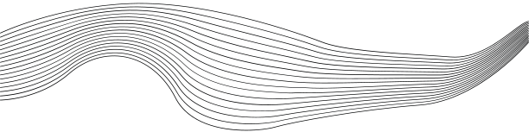
CONTENT
01
INTRODUCTION
02
PROBLEM DEFINITION
03
OBJECTIVE
04
ISURVEY/IDEAS
05
SYSTEM ARCHITECTURE
06
DETAILED DESIGN
07
TOOLS AND TECHNOLOGIES USED
08
SCREENSHOTS/VIDEOS OF THE OUTPUT

Slide 3




INTRODUCTION
Interviews play a key role in determining one's career path. However, many candidates struggle with confidence, body language, and answering questions correctly under pressure.
Our project is an AI-powered mock interview system designed to prepare candidates by analyzing their facial movements, emotions and correctness of answers. Personalises their preperation journey.

Slide 4





PROBLEM DEFINITION
LIMITATIONS
TIME
PERSONALIZATION
Current mock interview systems only focus on questions and answers, ignoring critical factors like body language, speech fluency, and real-time feedback.
Manual interview feedback is time-consuming and lacks objectivity.
There’s no integration between resume parsing and question generation in mock interviews, leaving candidates with generic questions that don’t align with their profiles.

Slide 5

OBJECTIVES
Analyzes video for confidence, body language, and non-verbal cues using FER and analyzes audio for speech fluency and confidence.
Generates interview questions from the user's resume using Natural Language Processing (NLP) and converts them to speech.
Validates the user's answers for correctness using AI-based models.
Calculates an overall score and provides suggestions for improvement in the interview performance.

Slide 6
SYSTEM ARCHITECTURE

Slide 7
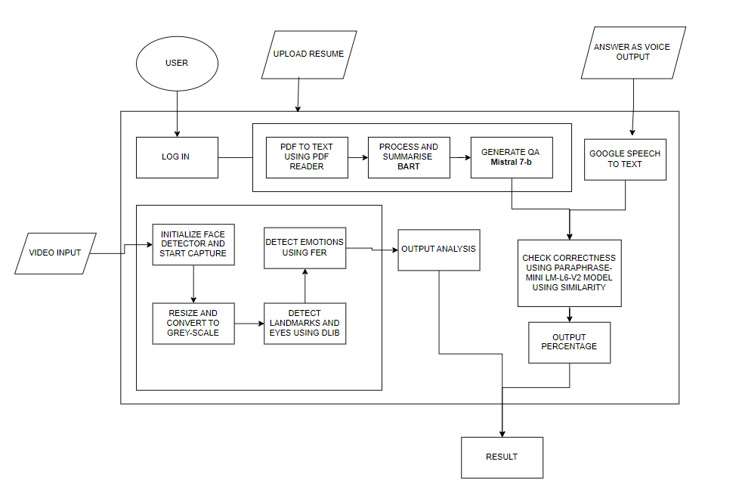

Slide 8

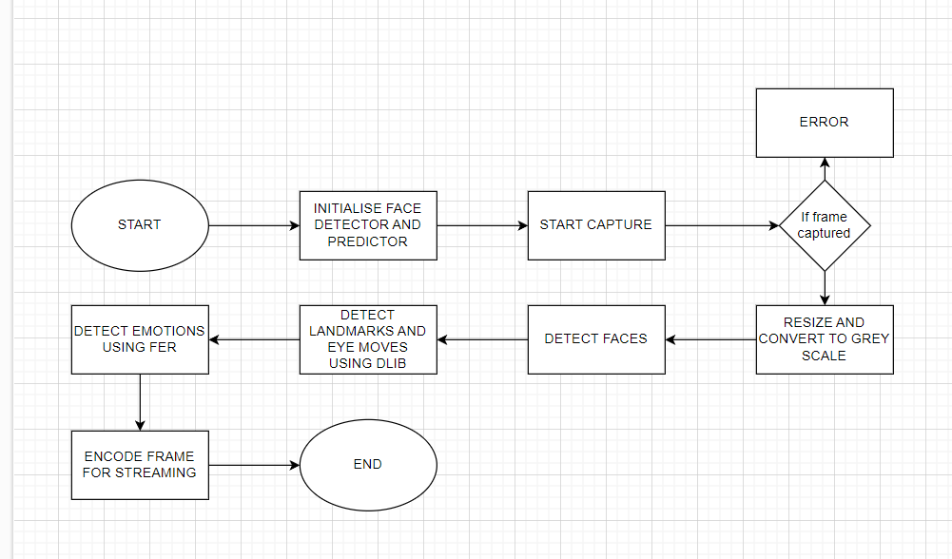
VIDEO ANALYSIS
NO
YES

Slide 9
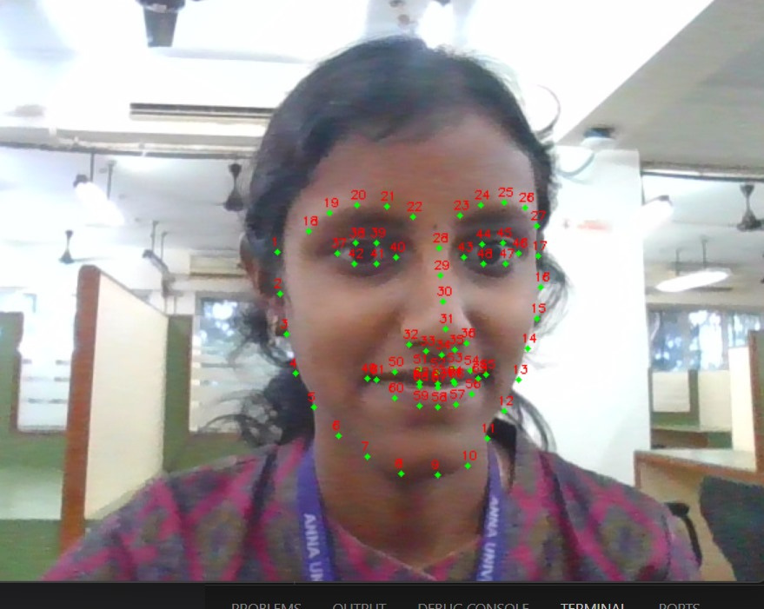
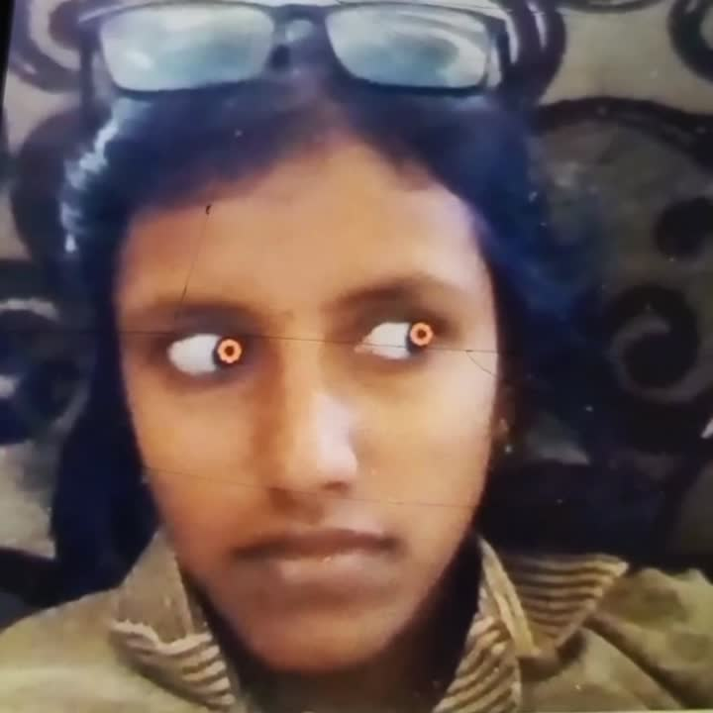
VIDEO ANALYSIS

Slide 10
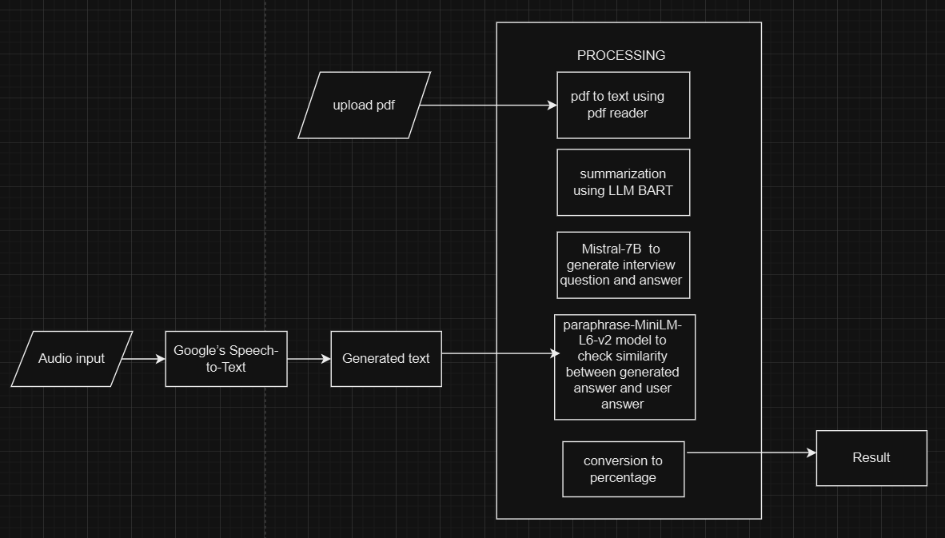
RESUME UPLOAD

Slide 11
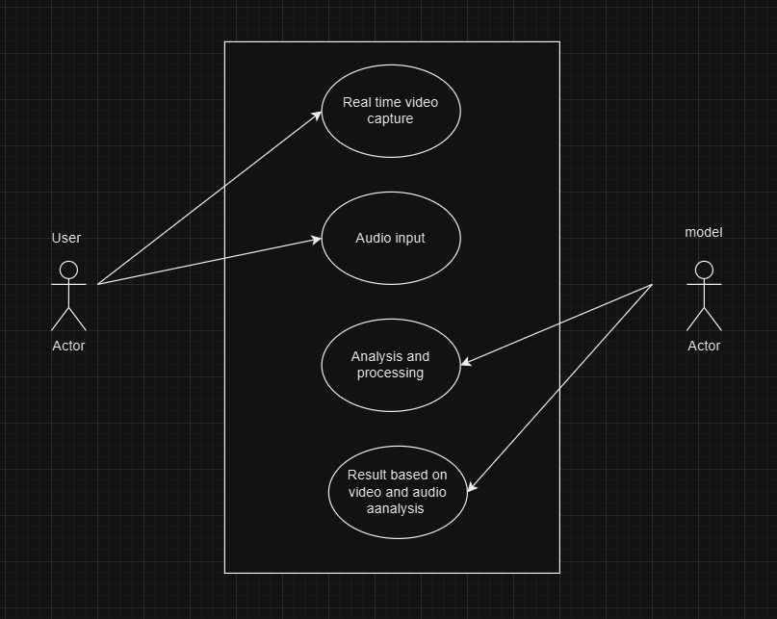
USE CASE DIAGRAM

Slide 12

TOOLS AND TECHNOLOGY USED
Hugging Face API: Utilized to generate generic questions from the candidate’s resume using pre-trained NLP models for contextual understanding.
Web Scraping (BeautifulSoup, Selenium): Used to fetch subject-specific interview questions from various resources online, based on the candidate’s educational background or experience.
BERT (Bidirectional Encoder Representations from Transformers): For evaluating the correctness of candidate answers by comparing semantic meaning between expected and given answers.
dlib: Used for tracking eye movement to assess candidate focus, engagement, and confidence.
FER (Facial Expression Recognition): Used for detecting emotions
ANSWER ANALYSIS
VIDEO ANALYSIS
QUESTION GENERATION

Slide 13



RESULTS
Eye movement and Emotion analysis helps assess the candidate’s focus and confidence, providing insights into engagement and nervousness levels.
Resume-based question generation produces highly relevant and tailored questions, making the interview more personalized.
Audio analysis effectively detects correctness of answers.

Slide 14
RESULTS

Slide 15
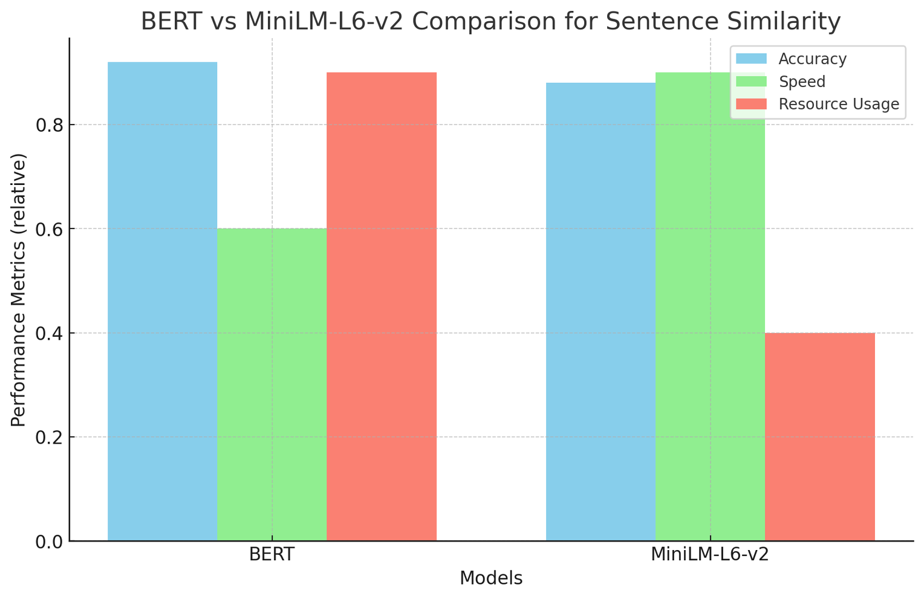
similarity checking

Slide 16
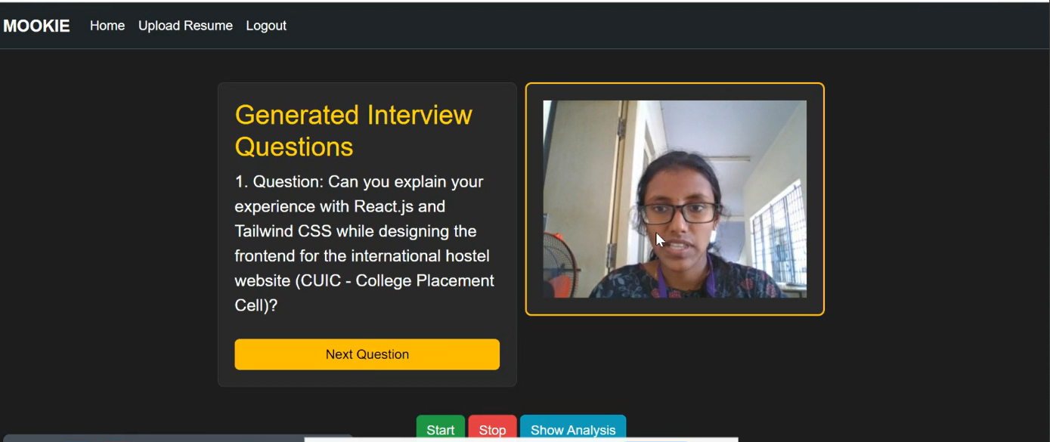
eye movement tracker

Slide 17
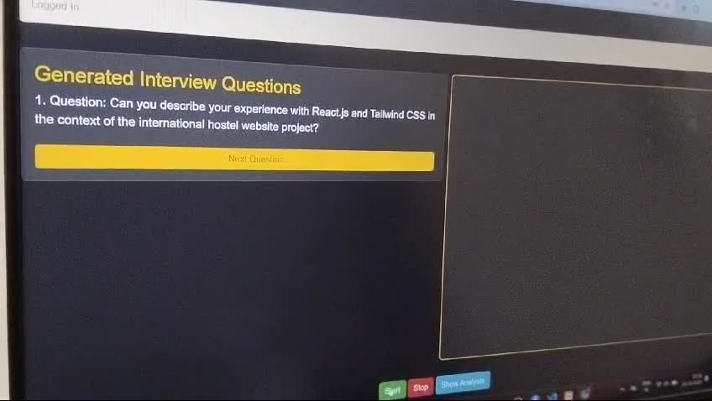

Slide 18
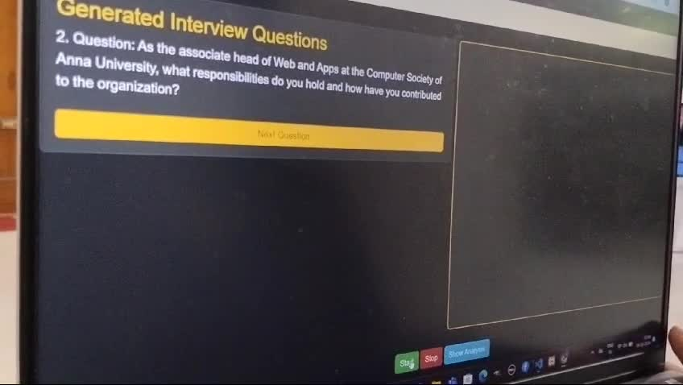

Slide 19
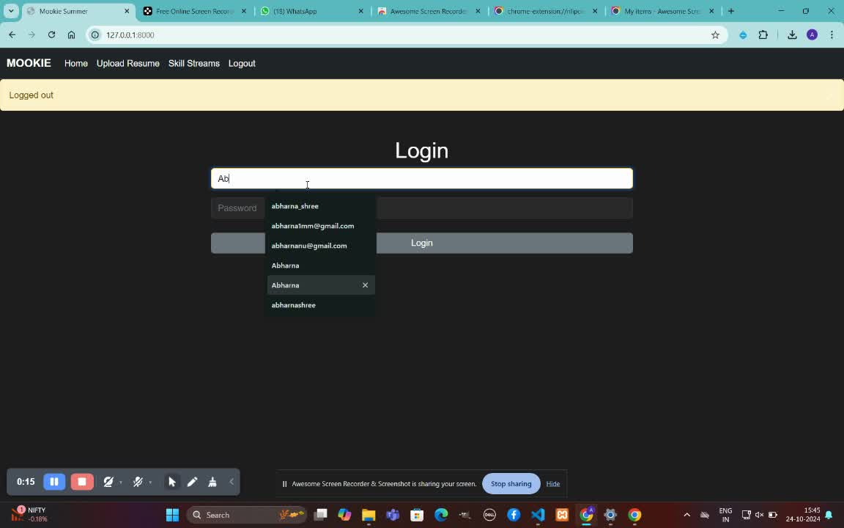

Slide 20

REFERENCES
King, D. E., "Dlib-ml: A Machine Learning Toolkit." Journal of Machine Learning Research .
S. Zheng et al. (2021): Use of MT-CNN for facial detection in real-time scenarios.
Reimers, N., and Gurevych, I. "Sentence-BERT: Sentence Embeddings using Siamese BERT-Networks." EMNLP-IJCNLP
Li et al. (2020): Research on contextual question generation from resumes and unstructured text.

Slide 21

THANK YOU

